Slide 1
DeepSeek-Janus
Focusing on the Method

Slide 2
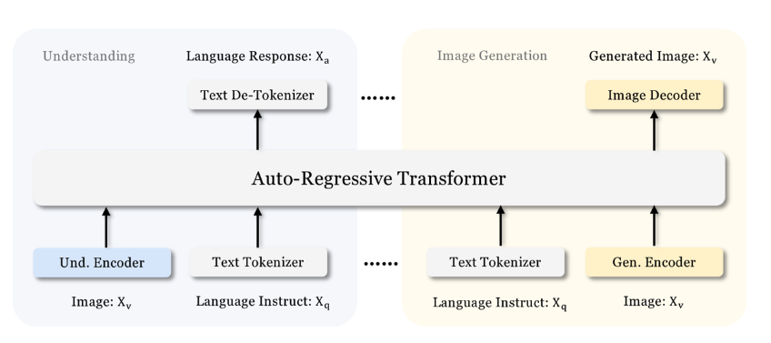
DeepSeek-Janus
Based on Auto Regressive Transformer
다음 토큰을 예측하는것이 기본적인 동작 방식

Slide 3
DeepSeek – Janus multimodal understanding
Pure Text
Understanding
LLM built-in tokenizer
Text
convert
Discrete IDs
Tuned for text prediction
Built-in prediction head of LLM
LLM input space
mapped feature
Multimodal
Understanding
mapping
Understanding Adaptor
1-d seq
Color coding
Task
Module
Data
tuned
Flatten
Image
SigLIP
encoding
High dim Feature

Slide 4
DeepSeek – Janus visual generation
Color coding
Task
Module
Data
tuned
Image
VQ tokenizer from “Llama Gen”
Discrete ID
flatten
1-D vector
Generation Adaptor
Generated Image
Mapping ID : codebook embedded
Processing
Randomly initialized
prediction head LLM
LLM
Multimodal
Feature seq
Feature Sequences
(Codebook friendly mapped vector)
concat

Slide 5
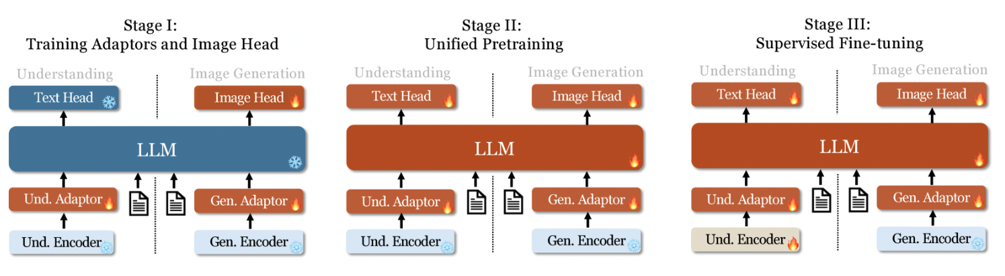
Before Training Session
LLM 학습의 Traditional 한 방식대로 진행됨
Adaptor 저놈이 뭐냐 <- finetuning 을 쉽게 하게 해주는녀석
LLM 튜닝을 위한 Skill
작은 모듈 붙여서, 그것들만 학습시키면서 성능을 증가시킴

